Slide 1
Compass and Range Finder
When a GPS only won’t do:
  Forestry canopies
  Canyons (no reception or can’t reach)
  Underwater
  Small areas when you don’t have a sub-meter GPS
  You can see but can’t get to the features
    Bottom of a canyon
    Across a stream
    Part way up a clif

Slide 2
Definitions
Bearing – direction to target (a.k.a. azimuth)
  Typically measured with a compass
Heading – direction of travel
  Note: A GPS provides a heading while you’re moving by finding the angle between your current location and a previous one. Because of this, it’s accuracy is poor and unreliable.

Slide 3
Basic Idea
Establish a “station” (a.k.a. benchmark) with more than adequate certainty
“Shoot” “meets and bounds” to points
  Measure direction and distance
Convert to coordinates
Must use a projected system!
  E.g. UTM, State Plane
Accuracy decreases as you move from point to point.
Notes:
In the forest, a general rule is that you will be off by 10% (i.e. if you go 1000 meters, you’ll be off by 100meters!).

Slide 4

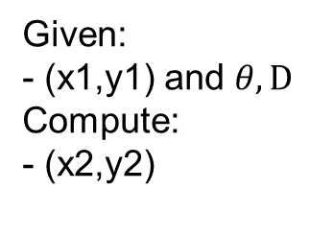
A little trig…
New Coordinate
(x2,y2)
North
dx
dy
D
Given:
- (x1,y1) and $θ, D$
Compute:
- (x2,y2)
$$θ$$
Existing Coordinate
(x1,y1)
Note: This only works in projected systems and there will always be error
Notes:
SOHCAHTOA
Sin(theta)=dx/D
Cos(theta)=dy/D

Slide 5
Compasses
The earth has a magnetic field that has a “north pole” and a “south pole” just like typical magnets
We can use this field and something that is magnetized to orient ourselves just about anywhere on the earth.

Slide 6
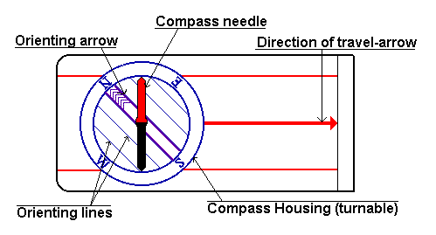
Field Compass
How to use a compass

Slide 7
Finding Direction
Point the “Direction of Travel-Arrow” in the direction you want to go
Turn the compass housing to make the north arrow (red part of the compass needle) line up with the orienting needle.
Check the direction of travel arrow again
Record the angle that is next to the direction of travel arrow
Add the appropriate amount of declination

Slide 8
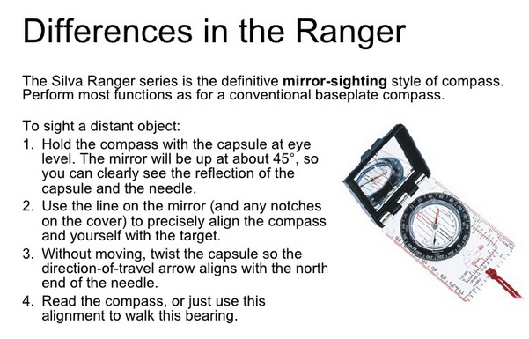
Mirror-sighting Compass
Wilderness Learning Center

Slide 9
Declination
“North” is not magnetic north
Compasses measure magnetic north (approximately)
See: Wiki page at:
  https://en.wikipedia.org/wiki/Magnetic_declination
  Check out the cool animation on how declination has changed
Find out declination at:
  http://www.ngdc.noaa.gov/geomag-web/

Slide 10
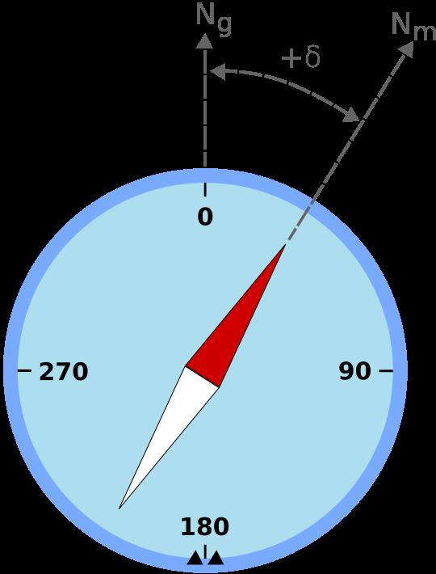
Declination
If we measure 0 degrees on a compass, the actually point is off by the “declination”.
We must add the declination to all our angles
Try it and check on a map

Slide 11
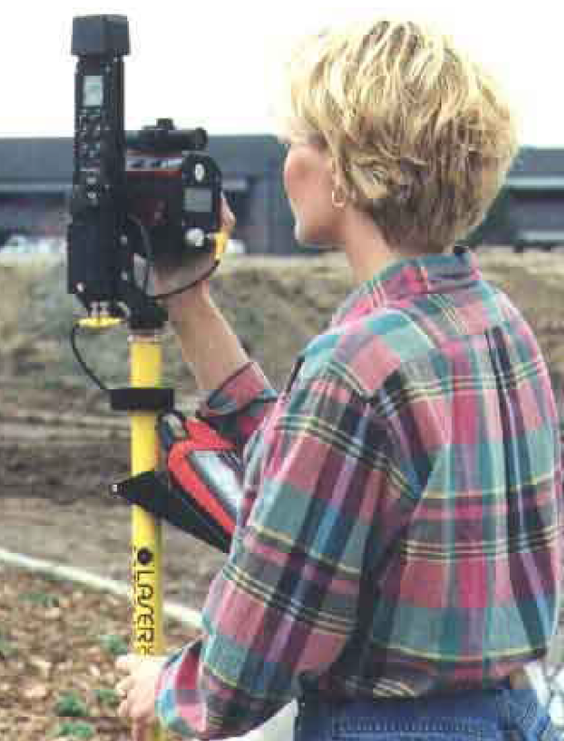
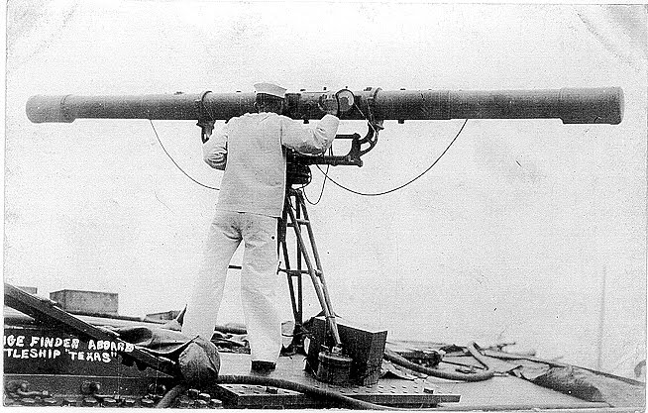
Measuring Distance
Best:
  Laser distance measuring tool
Next best:
  A lightweight measuring tape
Worst:
  Pacing

Slide 12
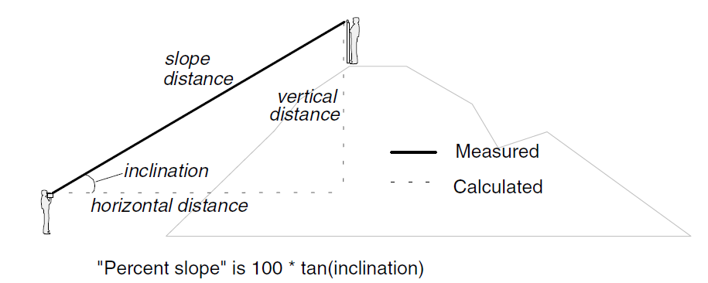
Distance with a Range Finder
The range finder will calculate the horizontal and vertical distance for you.

Slide 13
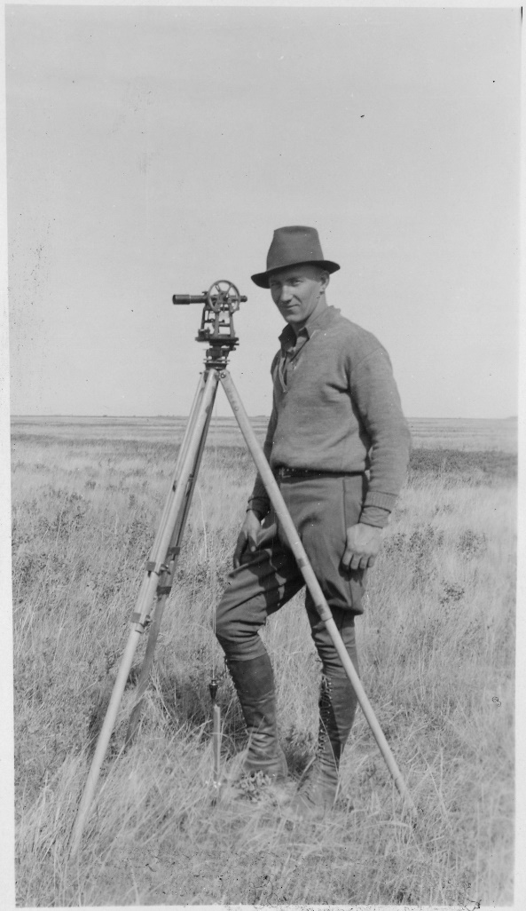
Leveling Rod
Without a leveling rod, inclinations and horizontal distances will be incorrect
Can also adjust later

Slide 14
Range Finder
Using the range finder will change from one model to another so please consult the instructions that come with the range finder.
Note that you are only required to find the horizontal distance for this class.

